Slide 1
Deadlock
A set of blocked processes each holding a resource and waiting to acquire a resource held by another process in the set.
Example:
System has 2 tape drives.
P1 requests for one tape drive and the system allocates tape drive 1.
P2 request for one tape drive and the system allocates tape drive 2.
P1 request for one more tape drive and enter in waiting state.
P2 request for one more tape drive and it also enter in waiting state.
‹#›

Slide 2
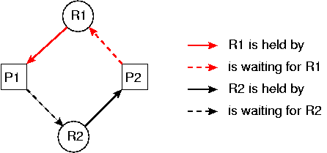
Deadlock example.
‹#›

Slide 3
Deadlock cont..
Process use a resources in following sequence of events.
Request: Process first makes a request for resources. If not available must wait. When available , request satisfied. But number of requests may not exceeded the total number of available units of resources.
Allocate: System allocate the resources . It maintain a table. Where records of resources , and which resource is allocated to which process. Also having queue for waiting process.
Release: After the process finished using the allocated resource , it release the resource to the system. System update the allocation.
‹#›

Slide 4
Deadlock cont..
If some of the processes entered in the waiting state, will never change state. Because requested resources are held by other waiting processes . This situation is called deadlock.
Resource can be , physical objects ( Disk drive , tape, CPU, RAM) and logical objects ( files, tables, database ) .
Preemptable, meaning that the resource can be taken away from its current owner (and given back later). An example is memory.
Non-preemptable, meaning that the resource cannot be taken away. An example is a printer.
‹#›

Slide 5
Necessary Conditions for Deadlock
Deadlock occurs if the following conditions hold simultaneously:
Mutual exclusion condition
Hold and wait condition
No-Preemption condition
Circular-wait condition
‹#›

Slide 6
Necessary Conditions for Deadlock cont…
Deadlock occurs if the following conditions hold simultaneously:
Mutual exclusion: only one process can use a resource at a time.
Hold and wait: Processes are allowed to request for new resources without releasing the resources that they are currently holding.
No-preemption: If a process has a resource , cannot be preempted.
Circular-wait: Two or more processes form a circular chain.
‹#›

Slide 7
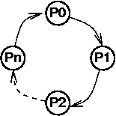
Circular wait
‹#›

Slide 8
Deadlock Modeling
Directed graph (consists of node and edges)
Path ( a to b )
Cycle (first and last node same)
Knot (A knot contain one or more cycles)
This graphs consist of nodes (a,b,c,d,e,f)
Set of edges {(a,b),(b,c),(c,d),(d,e),(e,f),(f,a),(e,b)}
Two cycles (a,b,c,d,e,f,a) and (b,c,d,e,b)
One knot (a,b,c,d,e,f) that contain two cycle.
b
a
c
f
d
e
‹#›

Slide 9
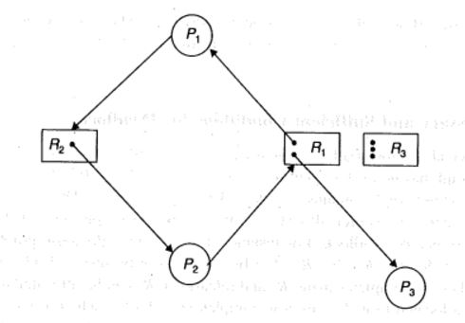
Deadlock Modeling cont..
Process nodes (circle) P1,P2
Resource nodes (rectangle) R1,R2
Units (bullets) Resources have more than one units
Assignment edges resource node to process node (R1,P1), (R1,P3) , (R2,P2)
Request edges Process node to a resource node (P1,R2) and (P2,R1)
‹#›

Slide 10
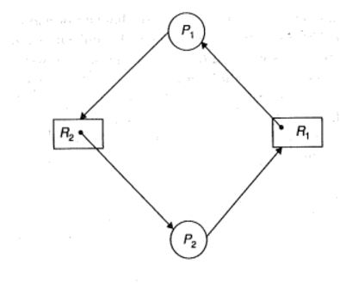
Necessary and Sufficient Conditions for Deadlock
A cycle is necessary condition for a deadlock.
‹#›

Slide 11
Necessary and Sufficient Conditions for Deadlock cont..
A cycle is necessary condition for a deadlock.
The presence of cycle is necessary condition for deadlock but not sufficient.
This diagram contains cycle but does not represent a deadlock.
When P3 completes its processing. It release R1. R1 assigned to P2.
P2 complete its job and release R2,R1.
R2 allocated to P1.
‹#›

Slide 12
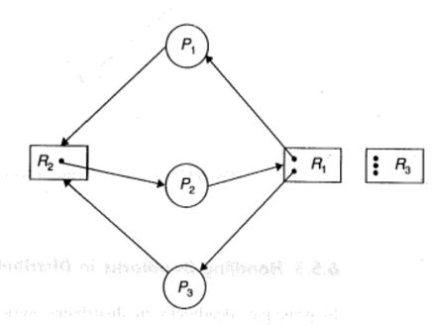
Necessary and Sufficient Conditions for Deadlock cont..
If processes forming a cycle , and one or more resources Ri have more than one unit, and a knot will be there, deadlock occurs.
P3 request for R2. (P3,R2) added to the graph.
This graph has two cycles (P1,R2,P2,R1,P1) and (P3,R2,P2,R1,P3) in knot (P1,R2,P3,R1,P1).
‹#›

Slide 13
Necessary and Sufficient Conditions for Deadlock cont..
Necessary and sufficient condition for deadlock can be summarized as follows:
A cycle is necessary for deadlock.
If there is a only single unit in one Resource in cycle.
If more than one unit are there in cycle, then a knot is sufficient for a deadlock.
‹#›

Slide 14
Wait-for graph (WFG)
When each resource has one unit , simplified form of graph is used.
Conversion from allocation graph to a WFG, removing the resource nodes.
This simplification based on , a resource can always be identified by its current owner ( process holding it ).
‹#›

Slide 15
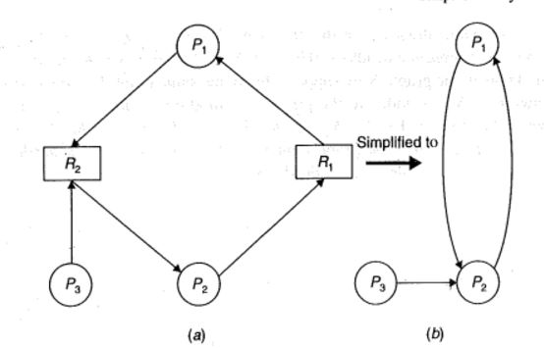

Slide 16
Handling Deadlocks
Prevention
Avoidance
Detection and recovery
‹#›

Slide 17
Deadlock Prevention
Designing the system in a way that deadlock become impossible.
Prevention is different from avoidance because no runtime testing (dynamically) of potential allocations need be performed.
Prevent the one of the four necessary conditions:
Mutual exclusion condition
Hold and wait condition
No-Preemption condition
Circular-wait condition
‹#›

Slide 18
Deadlock Prevention cont..
Mutual Exclusion
Unfortunately it is not possible to prevent deadlocks by denying mutual-exclusion.
Cannot be prevented for all resources. Some resources are intrinsically non-sharable for example printer, and some are sharable like CPU.
‹#›

Slide 19
Deadlock Prevention cont..
Hold and wait ( Collective Requests )
This method denies the hold-and-wait condition.
We must guarantee that whenever a process requests a resource, it does not hold any other resources.
Following policies maybe used to ensure this:
1. A process must request all of its resources before it begins execution. If all the needed resources are available , they are allocated to it. If one or more resources are not available , none will be allocated and process would just wait.
‹#›

Slide 20
Deadlock Prevention cont..
Problems in Hold and wait ( Collective Requests )
Low resource utilization because a process may hold many resources but all of them not used.
It may cause starvation because whenever a process made a request , resources are not available.
‹#›

Slide 21
Deadlock Prevention cont..
No-Preemption condition ( resources will be preempted)
A preemptable resource is one whose state can be easily saved and restored later.
A resource temporarily taken away from the process without harm to the computation performed by this process.
CPU, Main Memory are preemptable resources.
If the resources are preemptable, deadlocks can be prevented.
Two policies:
1. when a process requests for a resource, and resource is not available. Its already held resources taken away from it. And the process is blocked. The process is unblocked when the resources (requested by it, and preempted from it) available and allocated to it.
‹#›

Slide 22
Deadlock Prevention cont..
No-Preemption condition ( resources will be preempted)
2.When a process requests a resource that is not currently available, the system checks, if the requested resource is currently held by another process that is already blocked and waiting for other resources. If so , the requested resource is taken away from the waiting process and give to the requesting process, otherwise condition-1 applied.
‹#›

Slide 23
Deadlock Prevention cont..
Circular wait condition (ordered requests)
Each resource (type) is assigned a global number to impose total ordering.
Impose a total ordering of all resource types , and require that each process can only requests resources in an increasing order of enumeration.
Process should not request a resource with a number lower than is already held resource.
If process request = j and process already held resource = I=i then, j > I
Single request will be enough for the same resource type.
It has proven that with this ,graph can never have circular-wait.
If tape drive =1 , disk drive = 5, printer = 12, after getting tape drive process can request for the disk drive, after disk drive process can request for the printer. But it a process have the number =5, it cannot request for the number=1 for tape drive.
‹#›
Notes:
‹#›

